Slide 1
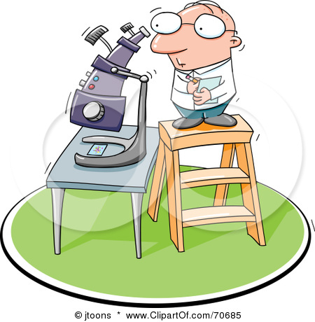
Microscopes

Slide 2
microscopes
Instruments used to examine things that are usually too small to be seen with the unaided eye.
Use glass lenses to produce magnified (enlarged) or larger-than-life images (representations or pictures) of objects.

Slide 3
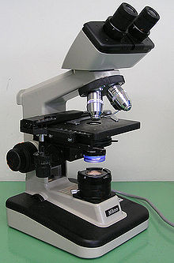
1. Light microscopes
Use beams of light to magnify an image.
Simple Light Microscope
Contains only 1 lens or lens system.
Compound Light Microscope
Contains more than 1 lens or lens system (EMS)

Slide 4
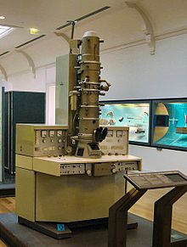
2. Electron microscopes
Use beams of electrons to magnify an image.
Examples:
Transmission Electron Microscope (TEM)
Sends a beam of electrons through an object to produce a flat-looking two-dimensional image.
Scanning Electron Microscope (SEM)
Bounces electrons off the surface of an object to produce a three-dimensional image.

Slide 5
Light vs. electron
 | Light Microscope | Electron Microscope
Magnification Technique
Maximum Magnification
Max resolving power or limit of resolution
Type of Specimens
Use beams of light
Use beams of electrons
1500x
Over 250000x
0.000 000 7 mm or
0.0007 μm
0.0002mm or 0.2μm
live
dead

Slide 6
Microscope terms
Specimen
Organism you are looking at
Magnification
Extent to which an organism is enlarged
Resolving power
Ability to show objects or parts of objects as separate
Affects the sharpness of an image
Beyond the limit of resolution, objects get blurry and detail is lost
Ex. Human eye = 0.1 mm
Illumination
Brightness of the field of view
Depth of field
Thickness of the image that is in focus at any one time when a specimen is viewed with a microscope.

Slide 7
field of view (FOV)
The circular area you are actually viewing
Decreases as you increase magnification
LOW power MEDIUM power HIGH power
40x 100x 400x
FOV= 2.6 mm FOV = 1.5 mm FOV= 0.8mm
1 2
0 0.5 1
0.5

Slide 8
Metric conversions
Since specimens are very small, we will often use micrometers (µm)
1000 µm = 1 mm
10,000 µm = 1 cm
1,000,000 = 1 m
Ex. 3.4 mm = ______ µm
3.4 mm x 1000 µm = 3400 µm
1 mm

Slide 9
Actual size
Calculating the ACTUAL SIZE of your specimen
Actual size = field of view (FOV)__________
# of specimens that fit across the field
Ex. Find the actual size of this specimen:
15 cells fit across HIGH power
0.8 mm = 0.053 mm or 53.3 µm
15 cells

Slide 10
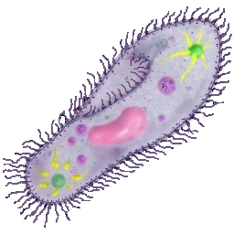
magnification
When you draw a diagram of your specimen, you must calculate how many times bigger it is than the actual size.
Magnification = Drawing size
Actual size
When you use this formula, the units must be the SAME before you divide.
Ex. If the actual size of the paramecium is 40 µm, calculate the drawing’s magnification
25 mm -> 25,000 µm = 625 X
40 µm

