Slide 1
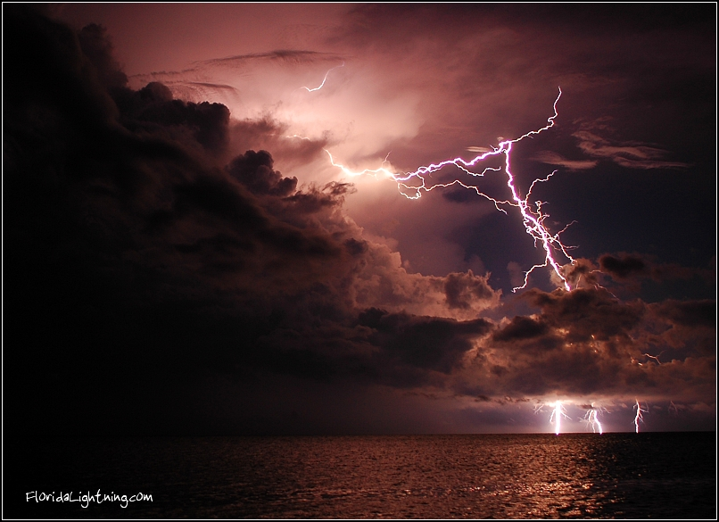
STATIC ELECTRICTY

Slide 2
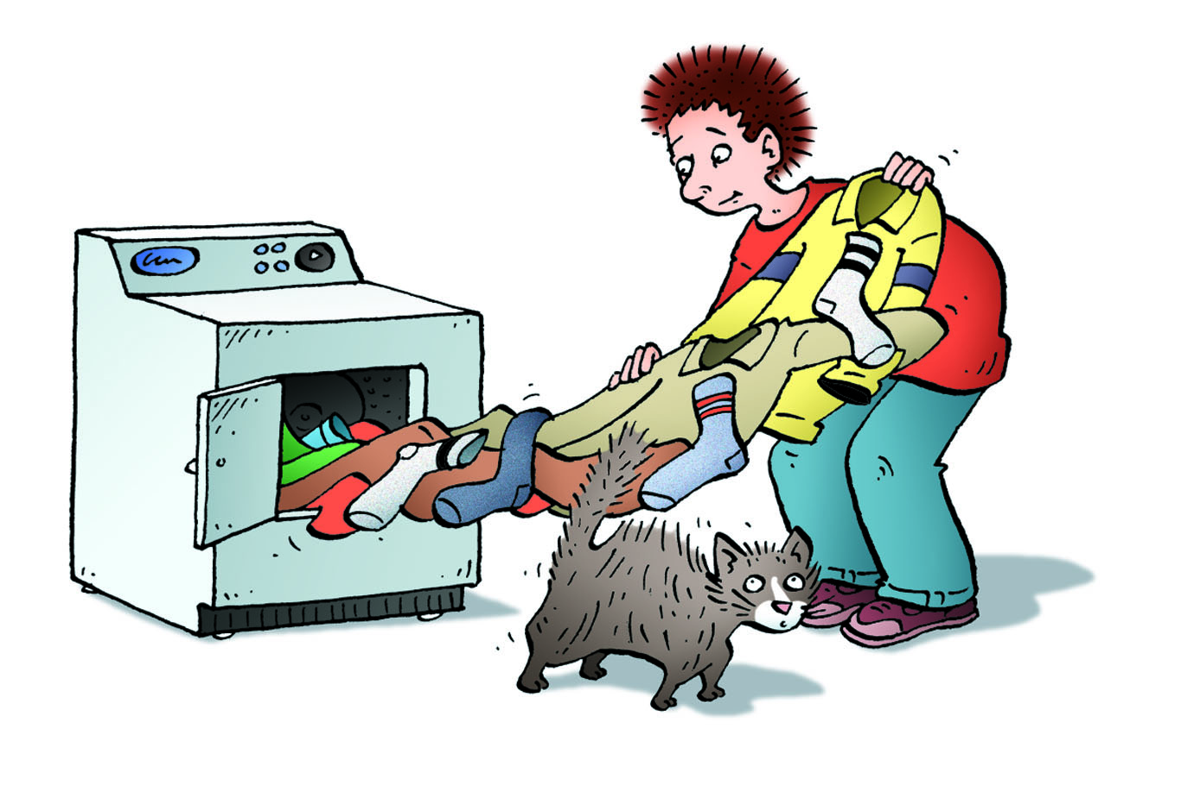

9.1 Types of Electric Charge
The effects of static electricity are all around you
  e.g. clothes from dryer, lightning, shocks from metal doors
A static charge is an electric charge that is stationary (not moving).
Eventually static charges are discharged, or lost, to other objects or to the air.
The study of static electric charge is called electrostatics.
We cannot see electric charge directly.
Instead, we observe its effects
  e.g. lightning is a discharge of static electricity

Slide 3
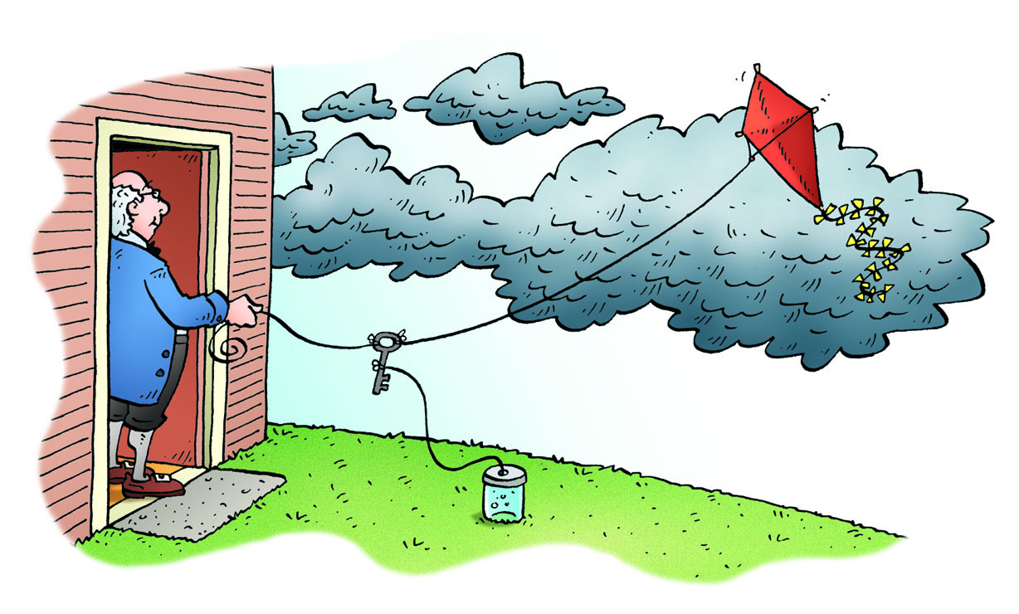
Types of Electric Charge
Benjamin Franklin showed that lightning is a form of electricity by flying a kite during a thunderstorm.
Because of experiments by Franklin and others, it was determined that there are two types of charges:
  positive and negative.
An object without any charge is neutral (0).

Slide 4
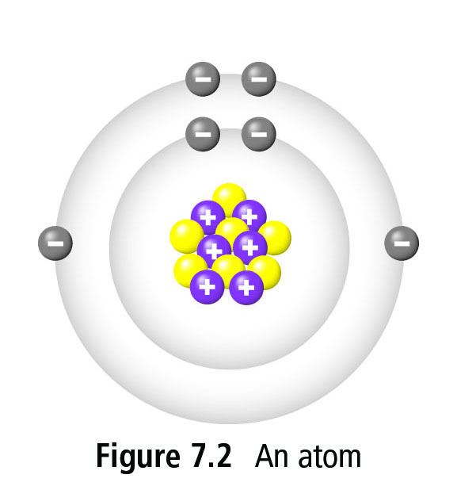
Atomic Structure and Electric Charge
Recall from chemistry that all matter is made up of tiny particles called atoms.
  Three smaller (subatomic) particles make up the atom: protons, neutrons and electrons.
Protons and neutrons are strongly attached to the nucleus but electrons are outside of the nucleus are can be easily added or removed.
Therefore, whether an object develops a negative or positive charge is due to whether it gains (-) or loses (+) electrons.

Slide 5
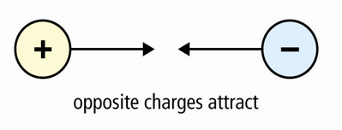
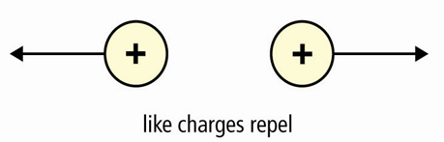

Laws of Electric Charges
The law of electric charges states that “like charges repel and unlike charges attract”
Two positive objects push away from eachother
Two negative objects push away from eachother
One positive and one negative will attract eachother

Slide 6
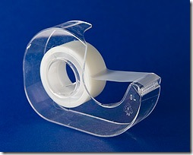
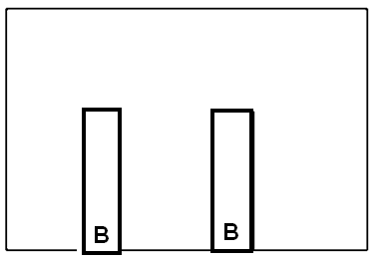
Exercise: Fun with Tape
Place 2 pieces of tape on your table and label the bottom ‘B’ for base

Slide 7
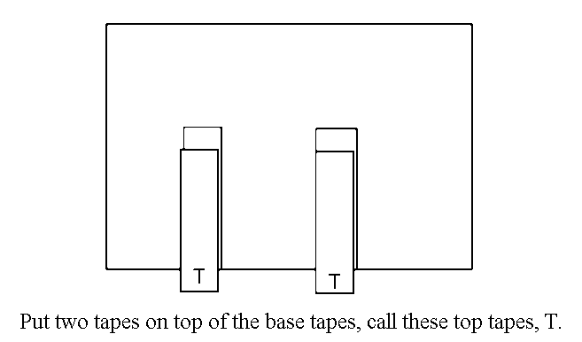

Slide 8
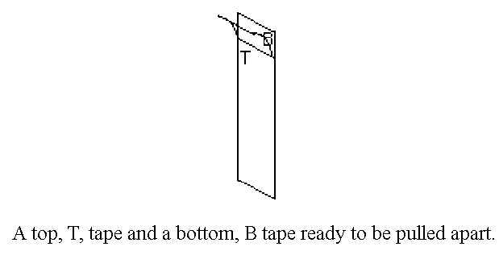

Slide 9
Static Electric Charge
An amber rod develops a negative charge when rubbed with wool or fur.
A plastic rod develops a positive charge when rubbed with cotton
When objects are rubbed against each other, they can transfer charge from one to another
  only electrons move around – not protons
Some materials are more likely than others to give up electrons.
  Ex. When acetate (a type of plastic used in overhead transparencies) is rubbed with paper, the acetate develops a positive (+) charge and the paper develops a negative (-) charge.
  Example: if rubber was rubbed with silk...silk is more likely to lose electrons so it would become positively charged, giving electrons to the rubber and making it negatively charged.

Slide 10
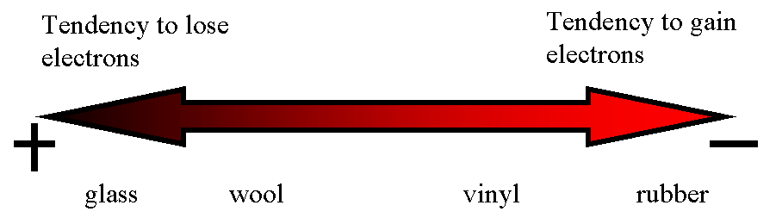
Pg. 276 Electrostatic series table
A list of materials in order of increasing attraction for electrons.
Movement of electrons

Slide 11
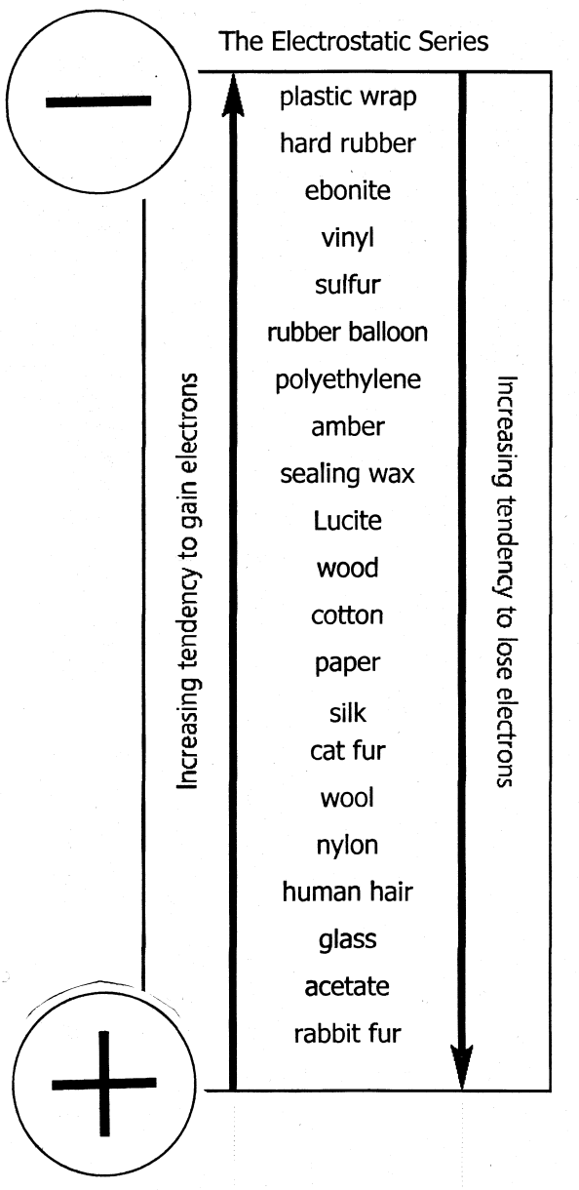
Attraction of Neutral Objects to Charged Objects
When a charged object is brought near to a neutral object, the electrons in the neutral object shift so that the end of the neutral object is attracted to the charged object.
Although there is a slight shift of charges within the neutral object, it does not gain or lose electrons and is still neutral.
This charging effect is known as induced charge separation.

Slide 12
9.2 Friction, Conduction, and Induction
Three methods of charging:
Friction: occurs when two objects are rubbed together
  the objects will have opposite charges at the end
Conduction (contact): occurs when objects touch and an electric charge is transferred from one object to the other
  both objects will have the same charge at the end
Induction: results from charging without touching or making any direct contact
  creates areas of opposite charge on the objects

Slide 13
Conduction
Occurs when objects touch and an electric charge is transferred from one object to the other.
  Ex. When you walk across a carpet and get a spark by touching a metal doorknob, you are transferring some of your charge to the doorknob.

Slide 14
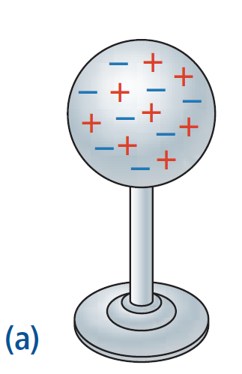
Charging by Conduction (contact)
A neutral metal sphere

Slide 15
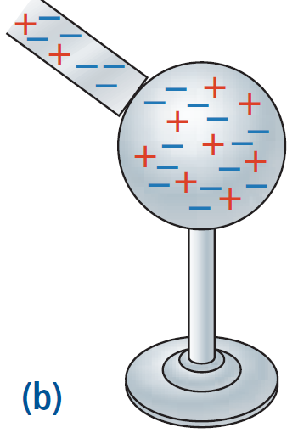
When a negatively charged bar contacts the sphere, some of the extra electrons move to the sphere, giving it a negative charge.

Slide 16
Induction
When objects are charged without touching or making any direct contact
IF we bring a charged object near to a neutral object, we can induce a charge in the neutral object because electrons move to get farther away from other electrons or closer to protons.
  Ex. Build-up of dust on a TV screen

Slide 17
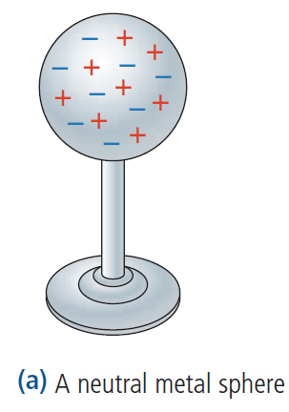
Charging by Induction
What happens when a negatively charged bar comes near the sphere?

Slide 18
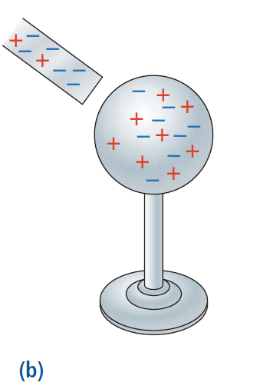
the charge on the bar causes, or induces, the electrons on the sphere to change their position.

Slide 19
Charging by Friction
When 2 objects are rubbed together.
    Ex. Electric charge built up on clothes as they tumble against each other in a dryer.
  Friction causes electric charges to be transferred from one object to another.

Slide 20
9.3 Insulators and Conductors
Some materials are able to acquire electrical charges that stay on them for some time.
These materials are called insulators.
Insulators are substances in which the electrons are so tightly bound to the atoms making up the material that they are not free to move to a neighboring atom.
  E.g. plastic
Other materials, called conductors, allow electrons to flow freely from one atom to another E.g. metals
  See Table 1 (p. 282) for examples of insulators, conductors and semiconductors

Slide 21
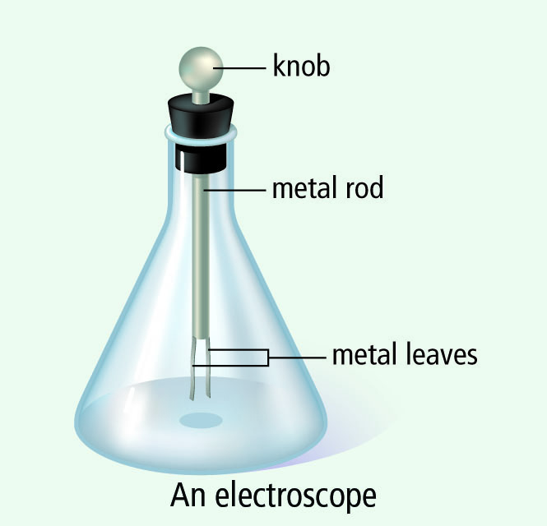
A Metal-Leaf Electroscope
Used to determine the presence of electric charges.
When a negatively charged strip is brought near the electroscope, it induces a separation of charge.
The ball on the top of the electroscope becomes positively charged and the two leaves become negatively charged.
Since the two leaves have the same charge, they repel each other and spread out.
When the charged object is removed, there is no longer and induced separation of charge and the leaves return to their original position.

Slide 22
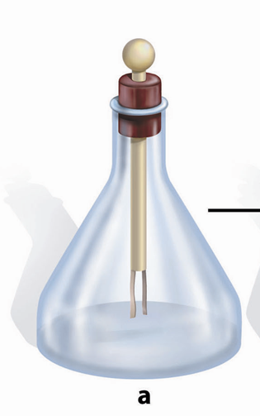

To ensure the electroscope is neutral, all excess charges need to be removed, or discharged, by grounding it.
An object is grounded if it is connected to Earth by a conductor.
If a conductor has a sharp point, that area receives a greater concentration of charge.
This is why lightning rods placed on the top of buildings have a pointed end.
A conductor goes from the rod to the ground which prevents the lightning from going through the building.

Slide 23
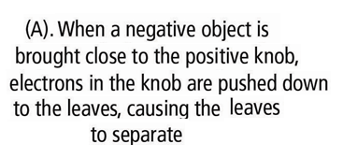
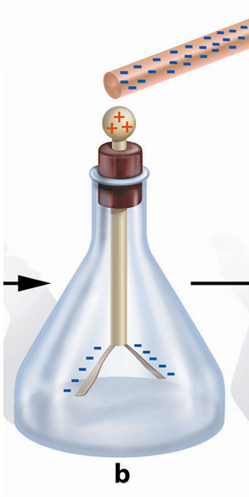
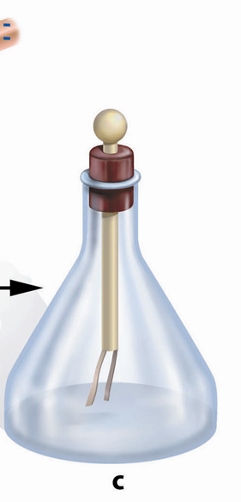
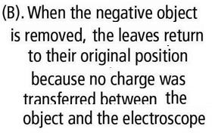


Slide 24
9.4 Electric Force

Slide 25
9.4 Electric Force
The Van de Graff generator is a device that separates large quantities of electric charge.
A charge (negative or positive) is transferred onto a moving belt at the base of the generator and is transferred off the belt onto the metal dome where they spread out across the outside surface.
Can produce very large electric charges which can be used to investigate electric forces.

Slide 26
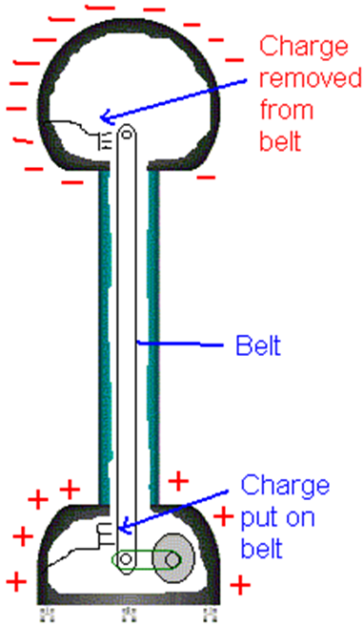
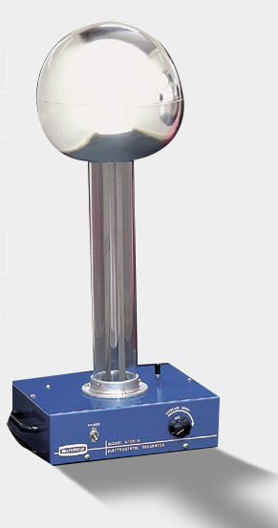
Van de Graff

Slide 27
The electric force (aka electrostatic force) is the force that exists between static charges.
It can either pull charges together (attraction) or push charges apart (repulsion)
The strength of the electric force increases with increasing electric charge and decreases with increasing distance (Coulomb’s Law)
The SI unit for size of the electric charge is called the Coulomb (C)
  Q: is the symbol for charge

Slide 28
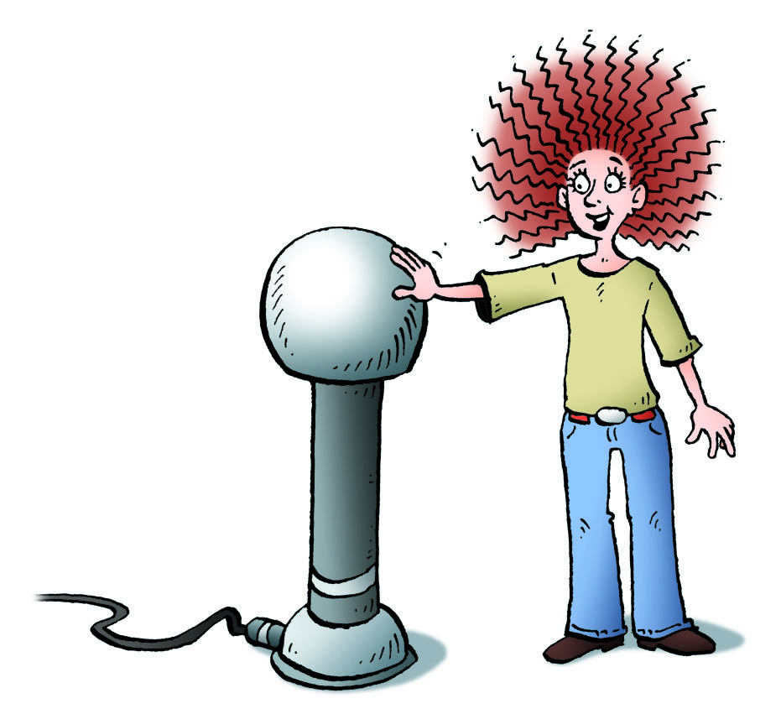
9.5 Applications of Static Electricity
There are several applications of static electricity such as
  Lightning
  laser printers
  fabric softener sheets and static cling
  electrostatic precipitators

