Slide 1
Current

Slide 2
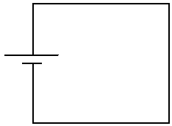
An electric cell (battery) uses a chemical reaction to create a “potential difference” between the ends of the battery.
That means that one end of the cell becomes positive and the other becomes negative.
When a circuit connects the two ends of the cell, current flows through the wire.
This is because electrons are repelled by the negative end of the cell and attracted to the positive end.

Slide 3
When scientists discovered electric current, they assumed that positive charges were moving.
This is called conventional current
defined as the direction positive charges move in a circuit
from positive to negative
we now know this isn’t the way it actually works.

Slide 4
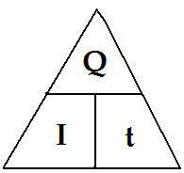
Calculating Current
Current is the amount of charge that passes a point in a current every second:
I = Q
t
I: is the symbol for current, measured in amperes (A)
Q: is the symbol for charge, measured in coulombs (C)
t: is time, measured in SECONDS (s)

Slide 5
Example #1
What is the current in a wire if 25 C of charge passes by a point in 5 seconds?
I = Q = 25 = 5 A
t 5

Slide 6
Example #2
If the current in a wire is measured to be 12 A, how much charge passes by a point in the circuit every minute
Q = I x t
= 12 A x 60 sec.
= 720 Coulombs (C)

Slide 7
Example #3
A current of 64 mA is equivalent to ____________________ A.
64 mA x 1 A = 0.064 A
1000mA

Slide 8
Current is measured by a device called an ammeter.
Typical amounts of current:
In a light bulb is 1A
In a TV is 4A
In a car starter is 500 A

Slide 9
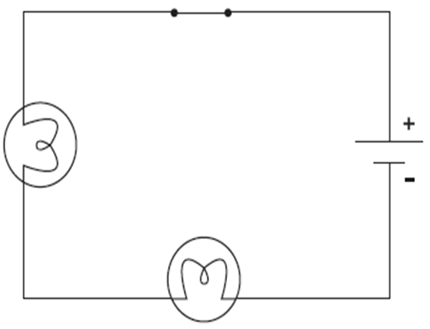
Series vs. Parallel
In a circuit, devices (such as light bulbs or batteries) can be placed in two different ways.
1. SERIES
When devices are placed in series, the current goes through a single path through all devices.
In this circuit, there is only one path and the current goes through the two light bulbs in the series.

Slide 10
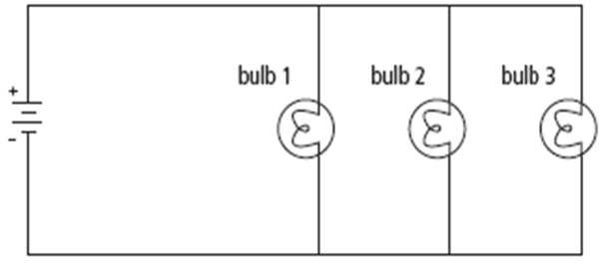
2. PARALLEL
When devices are placed in parallel, there are 2 or more paths that the current can take
it splits and some of it goes through one device, and some of it goes through the other(s).

Slide 11
Decide whether each circuit is Series, Parallel, or a Combination of the two.
SERIES
PARALLEL
SERIES
PARALLEL
SERIES
PARALLEL
SERIES
SERIES
SERIES
PARALLEL

Slide 12
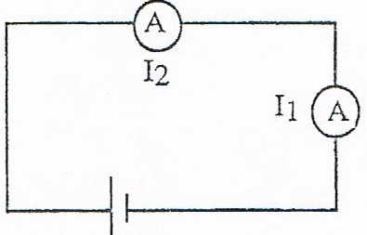
Calculating Current in SERIES
Current (I)
Measured in Amperes (A)
When you place an Ammeter in SERIES (SIDE BY SIDE) the current stays the same
Series:
I_{Total} = I₁ = I₂

Slide 13
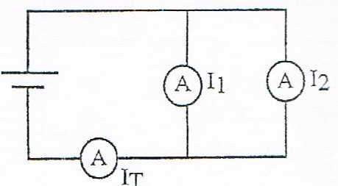
Calculating Current in PARALLEL
Current (I)
Measured in Amperes (A)
When you place an Ammeter in PARALLEL (OPPPOSITE FROM EACHOTHER), you add the current to find a total.
Parallel:
I_{Total} = I₁ + I₂

Slide 14
Example #4
Find the total current for the following circuit.
I_{Total} = I₁ + I₂
I_{T} = 10 A + 12A
I_{T} = 22 A
10 A
12 A

Slide 15
Example #5
12 A
Find the total current for the following circuit.
I_{Total} = I₁ = I₂
= 12A = 12 A
= 12 A

Slide 16
Example #6
How long does it take 40 C of charge to pass by a point if the current in the circuit is 0.76 A ?
t = Q = 40 = 52.6 s
I 0.76

