Slide 1
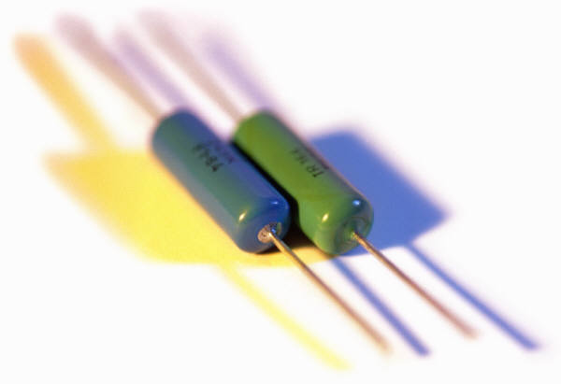
Resistance

Slide 2
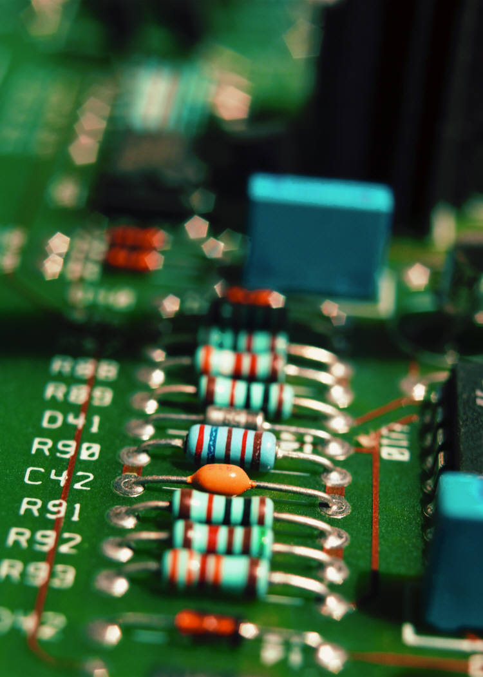
Resistor
A resistor is part of an electric circuit that resists the flow of electric current.
As current flows through a resistor, some of the electrical energy is transformed into another form, such as light or heat energy.

Slide 3
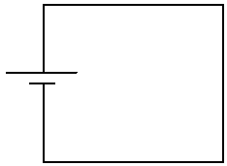
ohm (Ω)
The symbol for a resistor is:
The unit for measurement of a resistor is the ohm (Ω).
Some of the current gets converted/used as “light” energy!
When a resistor is connected to an electric cell, the amount of current that flows through the circuit depends on the amount of resistance

Slide 4
The resistor color code table can be found in your text on pg. 316
Colour | Numeric Value
Black | 0
Brown | 1
Red | 2
Orange | 3
Yellow | 4
Green | 5
Blue | 6
Violet | 7
Grey | 8
White | 9

Slide 5
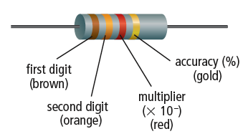
This example has a value of 13 x 10 ² Ω
= 1300 Ω

Slide 6
Give the value of each resistor indicated by the colour bands.
6500 Ω
700 000 Ω
560 Ω
12 Ω
87 000 Ω
2100 Ω

Slide 7
Example #1
The value of a resistor is 230 Ω. What are the first three bands of colour on this resistor?
red, orange, brown
The value of this resistor is 6400 Ω. What are the first three bands of colour on this resistor?
blue, yellow, red
Example #2

Slide 8
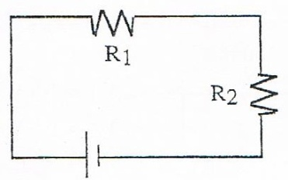
Resistors in SERIES
Resistors can also be connected in series and parallel.
The same rules apply for finding total resistance as they did for total voltage.
Total Resistance INCREASES with the number of resistors in series.
R_{T} = R₁ + R₂ + R₃

Slide 9
SERIES examples
Calculate the total resistance (R_{T}) for the following combinations of resistors.
3 + 2 + 3 = 8 Ω 30 + 10 + 60 = 100 Ω

Slide 10
Resistors in PARALLEL
Total Resistance DECREASES in parallel.
1/R_{T} = 1/R₁ + 1/R₂ + 1/R₃
1/Rt = ½ + ¼ + ½
= 0.8 Ω = 21.1 Ω

Slide 11
Type of Circuit | Series | Parallel
Total Current (I_{T}) | I_{T} = I₁ = I₂ = I₃ | I_{T} = I₁ + I₂ + I₃
Total Voltage (V_{T}) | V_{T} = V₁ + V₂ + V₃ | V_{T} = V₁ = V₂ = V₃
Total Resistance (R_{T}) | R_{T} = R₁ + R₂ + R₃ | 1/R_{T} = 1/R₁ + 1/R₂ + 1/R₃

Slide 12
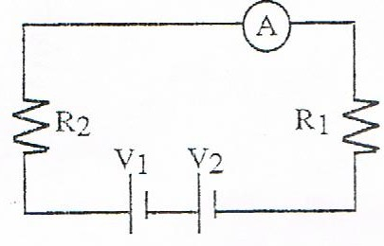
Find: V_{T} = _________ V₁ = 1.5 V
R_{T} = _________
I_{T} = _________ V₂ = 1.5 V
R₁ = 7 Ω
R₂ = 3 Ω
I₁ = 300 mA
V_{T} = 3 V
R_{T} = 10 Ω
I_{T} = 300 mA

Slide 13
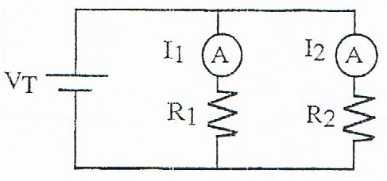
Find: I_{T} = _________ I₁ = 0.6 A
R_{T} = _________ I₂ = 0.6 A
R₁ = 15 Ω
R₂ = 15 Ω
V_{T} = 9 V
I_{T} = 1.2 A
R_{T} = 7.5 Ω

