Slide 1
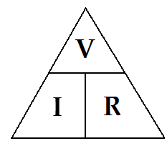
Ohm’s Law
The relationship between voltage, current and resistance is known as
Ohm’s Law: V = IR
Voltage (V) = Current (I) x Resistance (R)
Volts (V) amps (A) ohms (Ω)
The greater the amount of resistance, the lower the current
Resistance = Voltage ÷ Current R = V
I
Current = Voltage ÷ Resistance I= V
R

Slide 2
2. Fill in the following table and calculate Resistance.
2.4 Ω
2.65 Ω
2.4 Ω
2.5 Ω
2.4 Ω

Slide 3
Example #1
A current of 2.5 mA flows through a resistor when connected to a 16 V power supply.
What is the value of this resistor?
R = V
I
= 16 V
0.0025 A
6400 Ω

Slide 4
Example #2
What is the current produced by a potential difference of 240 volts through a resistance of 0.2 ohms?
R = 0.2 Ω
V = 240 V I = V
I = ? R
= 240 V
0.2 Ω
= 1200 A

