Slide 1
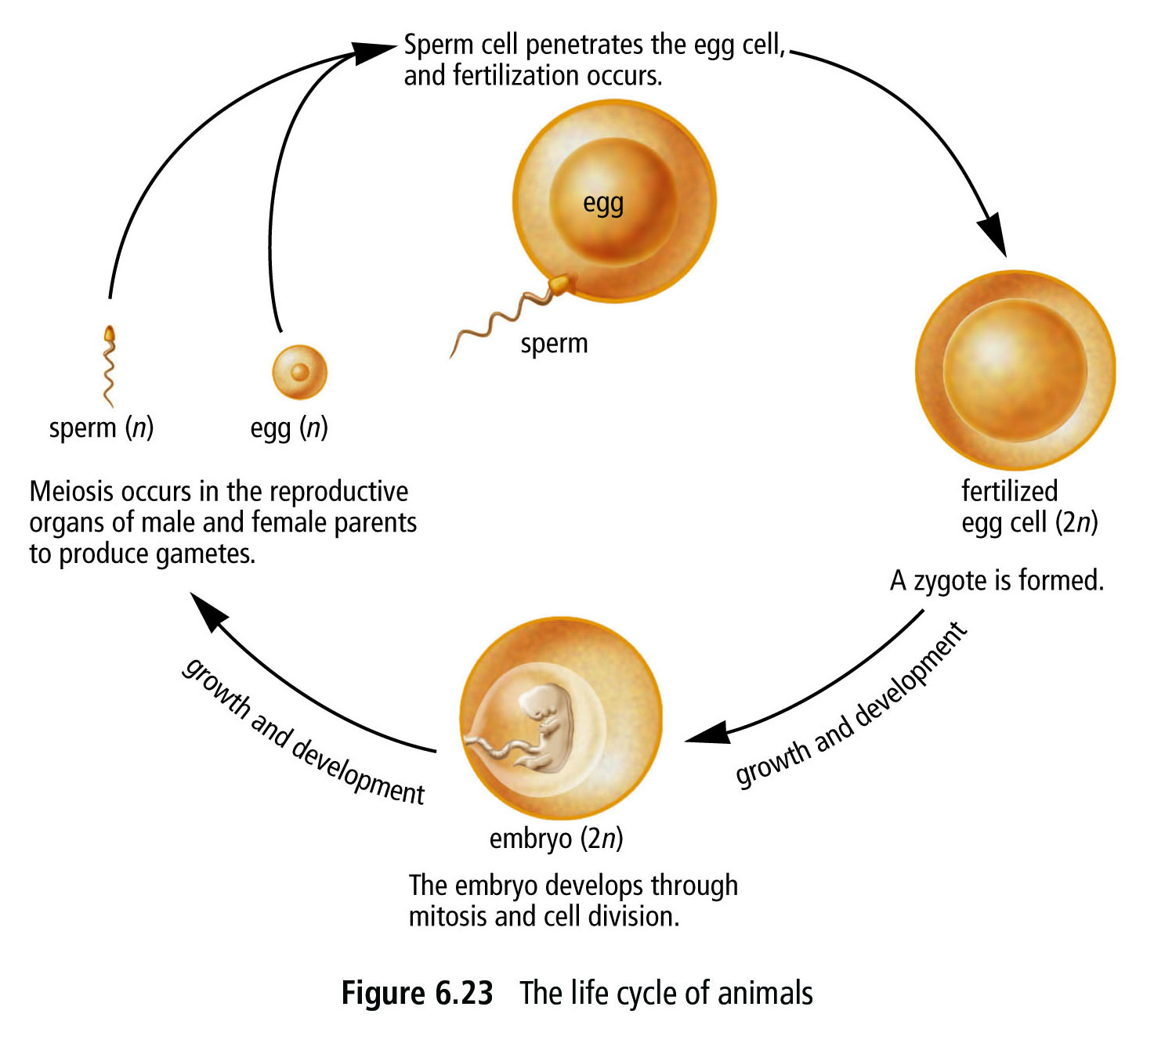
3.2 Sexual Reproduction & the Diversity of Life

Slide 2
3.2 Sexual Reproduction & the Diversity of Life
Joining or fusing two gametes is called fertilization
This will create a Zygote
first diploid (46 chromosomes) cell of the offspring
Sperm (n) + egg (n) = zygote (2n)

Slide 3
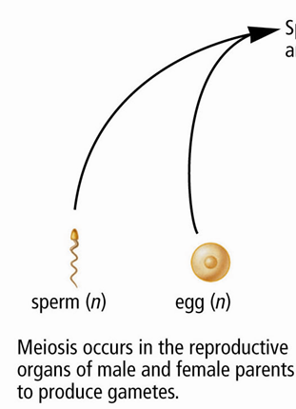
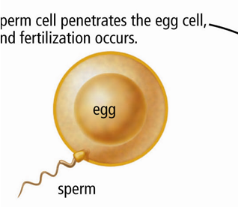
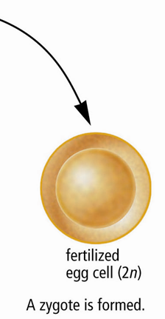
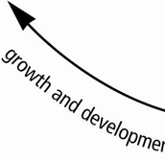
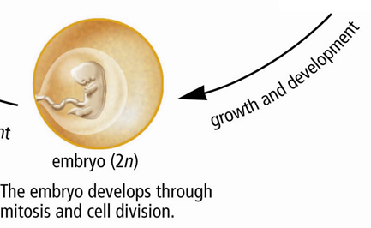

Slide 4
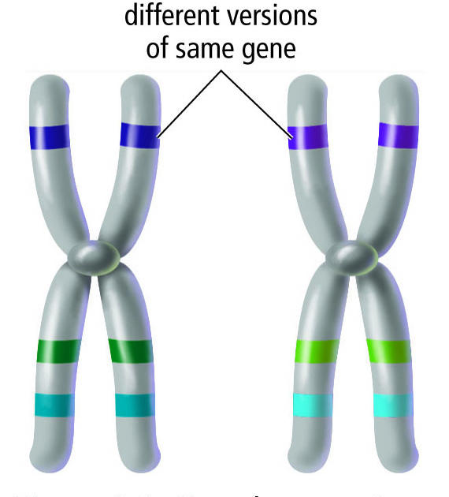
homologous chromosomes produce variation among individual members of a species
Because the genes on each may be slightly different.
Different forms of the same gene are called alleles.
This is why people have different coloured eyes, or why some people can curl their tongues and others cannot.

Slide 5
 | Sexual Reproduction | Asexual Reproduction
Advantages | Genetically different | If parent does well so will the offspring Only one parent required Can reproduce frequently Produces large numbers of offspring
Disadvantages | Needs to find a mate Produces fewer offspring Organism needs to grow & develop before they can reproduce. Ex Orcas 8-10yrs | Genetically identical, So if the environment changes all the offspring will be affected in the same way

Slide 6
3.3 Methods of Sexual Reproduction

Slide 7
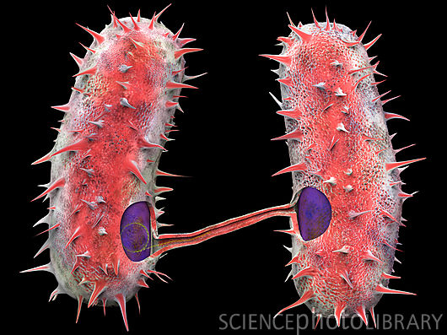
3.3 Methods of Sexual Reproduction
Conjugation
Occurs when two unicellular organisms transfer or exchange some of the genetic material
Only happens in some bacteria & protests
Increases the diversity of individuals in unicellular species
May be a factor that helps some bacteria become resistant to antibiotics

Slide 8
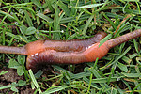
Hermaphrodites
Is an organism that produces both male & female sex cells in the same individual.
This allows them to mate with any other member of their species.
Ex. Earthworms very seldom see another earthworm so they are hermaphrodites, which allows them to mate with any earthworm they come across in their travels.

Slide 9
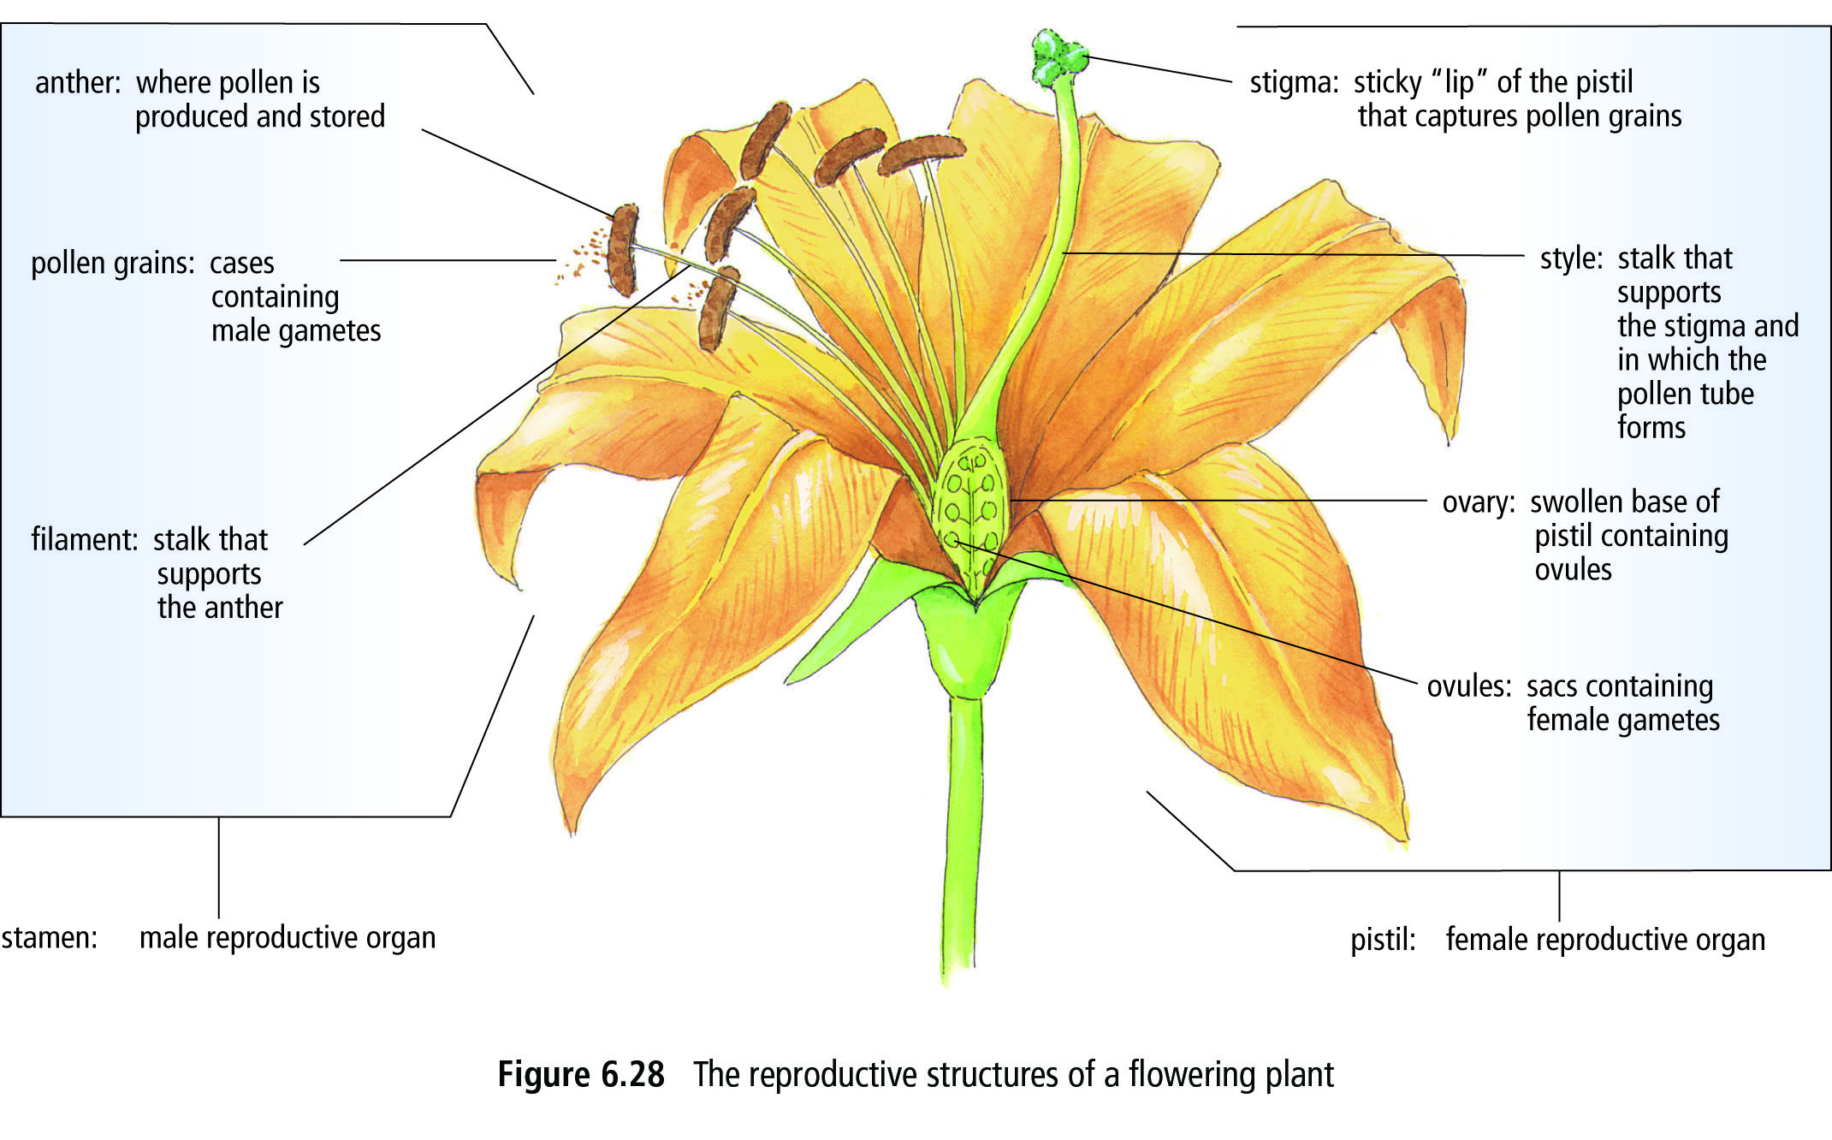
Flowering plants
Most flowers contain both male & female reproductive organs, so they are hermaphrodites.
Pollination is the transfer of pollen from the male structures to the female
Cross-pollination occurs by wind, insects, birds or mammals
Self-pollination can occur in some plants
Fertilization follows pollination

Slide 10
Separate Sexes
Animals as well as some plants
Two types of fertilization: Internal & External
Internal
The union of sperm & egg occurs inside the female
ADVANTAGE: More offspring survive
DISADVANTAGE: More energy to find a mate, production of fewer zygotes
Ex. Humans, Some aquatic animals such as Sharks, and most terrestrial animals
External
The sperm & the egg unite outside the body
ADVANTAGE: Little energy is needed to find a mate & large numbers of offspring are produced at one time
DISADVANTAGE : Many will not get fertilized, zygotes are unprotected
Ex. Many aquatic animals, such as Salmon

Slide 11
3.4 Development of the Zygote

Slide 12
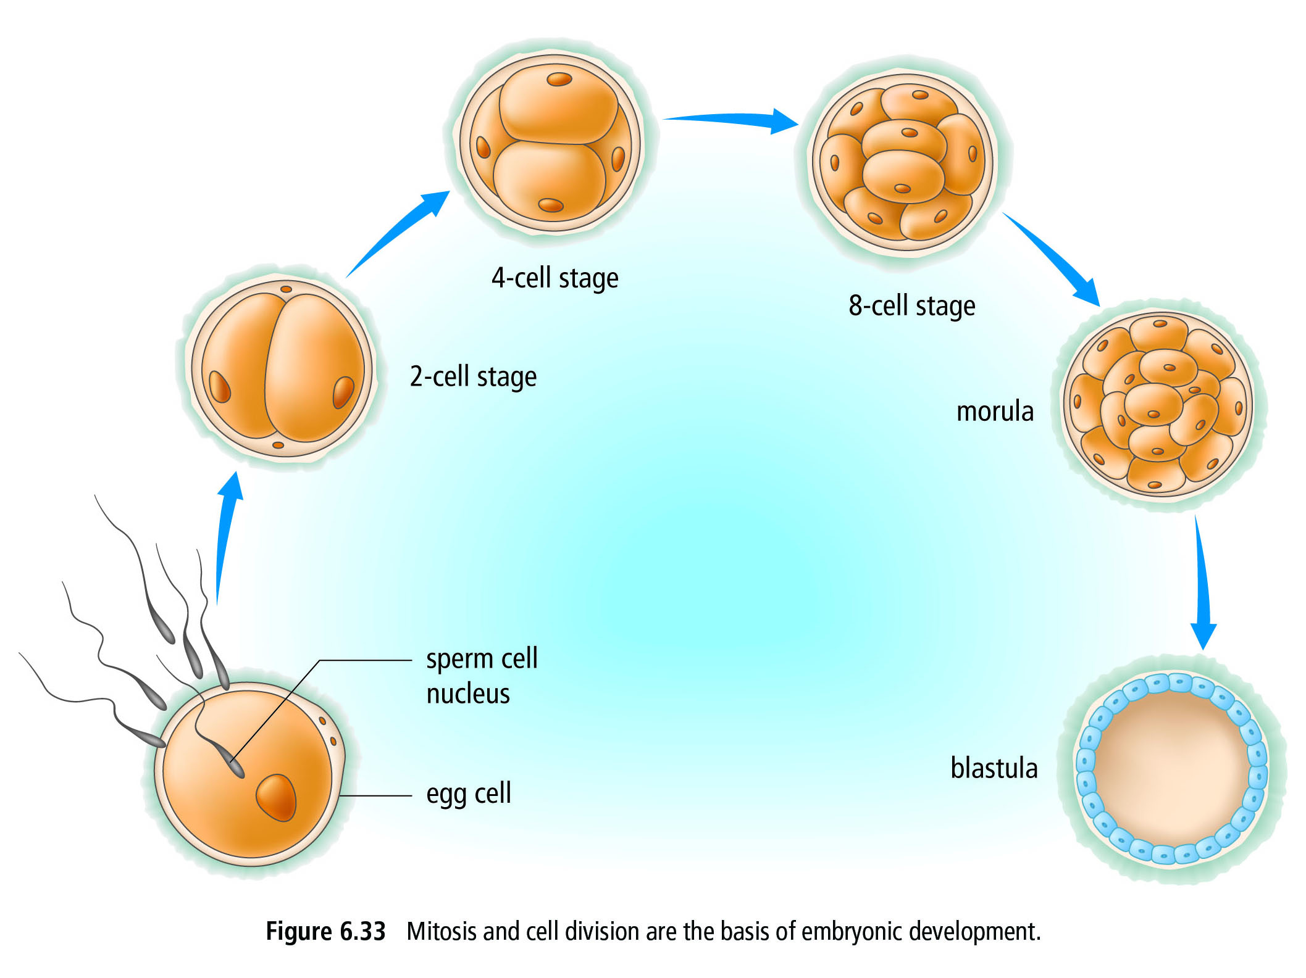
3.4 Development of the Zygote
Once a sperm & egg fuse to form a zygote, the zygote divides and becomes an embryo (developing organism)
Embryo is protected inside seeds, eggs, or the mother.
Mitosis and cell division are the basis of embryonic development

Slide 13
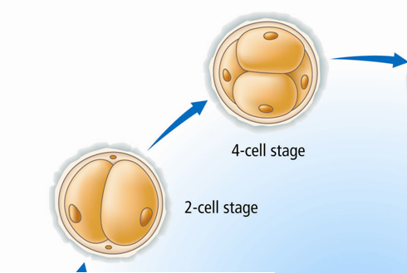
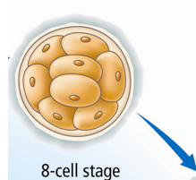
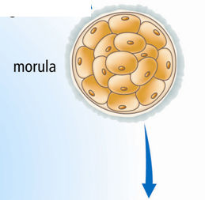
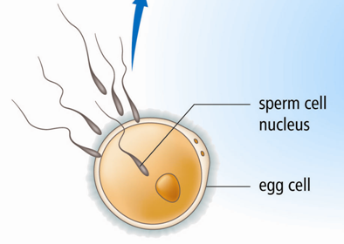
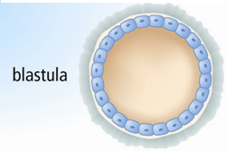

Slide 14
Development of a Zygote takes place in:
Mother
Embryos of all mammals except the spiny anteaters and platypus develop inside the mother.
Marsupials(Kangaroos, koalas, & opossums) embryo’s do not develop for very long inside the mothers uterus.
The young are born very tiny & immature.
They climb from the birth canal through the fur into a pouch that contains nipples of mammary gland.
Placental mammals, such as humans, embryo’s develop inside the mother for much longer then marsupial mammals.
The placenta which is the organ that develops around a fetus is connected to the mother , while the fetus is connected via the umbilical cord which carries wastes out & nutrients in.

Slide 15
Seeds
Contain the embryo as well as stored food.
The food provides the developing plant nourishment until it can produce its own using photosynthesis.
Eggs
Eggs that are laid contain the zygote, some nutrients, and a mechanism for protection, such as a shell, a jelly like substance, or an egg case.
There are many levels of parental care of eggs
Ex. Birds sit on them, sea turtles bury them and leave

Slide 16
3.5 Reproductive Technologies

Slide 17
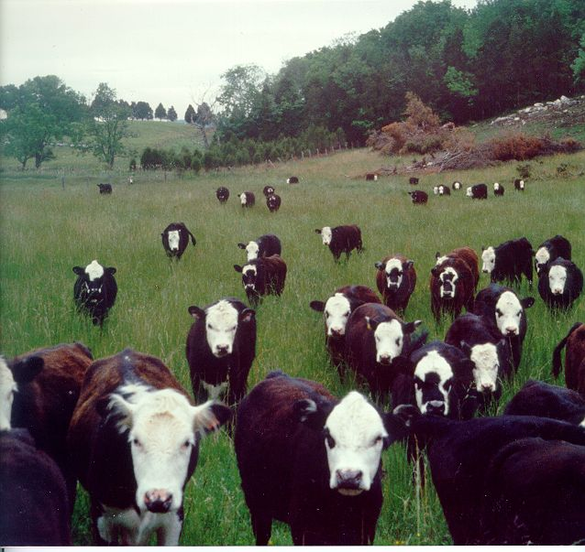
3.5 Reproductive Technologies
Two plants or two animals of one species that have desirable traits are bred with each other.
The breeder will keep selecting the offspring with the most desirable traits and then breed them until all the offspring have the desirable trait.
Ex. Cattle Beef have been breed to have high quality & quantity of muscle

Slide 18
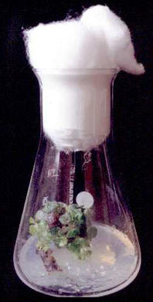
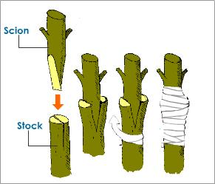
Artificial Vegetative Reproduction
Growers use cuttings to grow plants with desirable traits
A quicker way involves cloning, where individual cells are removed from a desirable plant and then are placed in a bottle or petri dish with nutrients & growth hormones.
Once they form roots they are planted in soil.
Grafting is another technique that involves attaching a branch from a desirable fruit tree onto the trunk of another tree that has excellent roots but poor fruit.

Slide 19
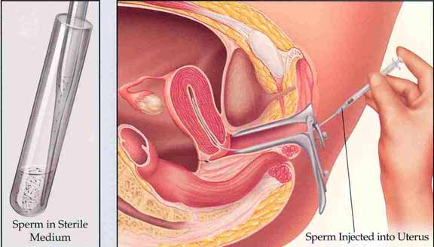
Artificial Insemination
A veterinarian collects sperm from male animal & inserts into a female animal of the same sex.
This helps animals to conceive more quickly & more often.
Used extensively in agriculture to help breed animals with desirable traits.
Ex. Dairy Cows, also used in Zoos to maintain or increase the population of endangered species.

Slide 20
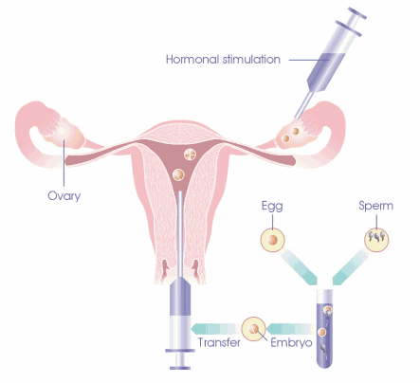
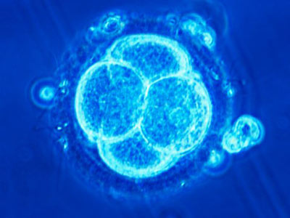
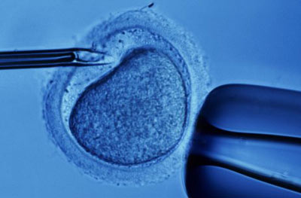
In Vitro Fertilization
Process that builds on artificial insemination
Both sperm & eggs are collected from animals with desired traits
Fertilization occurs in a lab, Petri dish
Once eggs are fertilized the embryos can be inserted into many different female cows.
These cows are surrogate mothers, because they are not genetically related to the embryo.

Slide 21
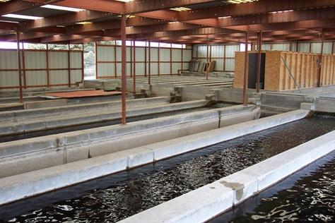
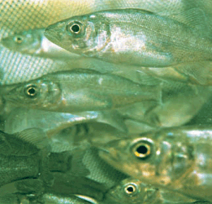
Hatcheries
Use technology to ensure a higher rate of survival.
Salmon are caught and their eggs & sperm are collected and mixed together in a container.
The fertilized eggs are incubated
Once they hatch they are fed, and then eventually released into the wild

Slide 22
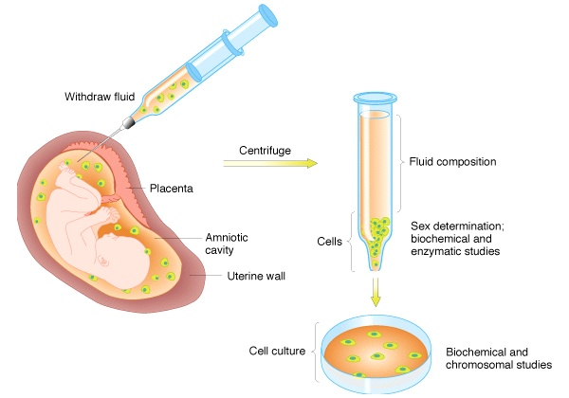
Recombinant DNA
Involves combining genes from different individuals or different species into a single molecule of DNA.
Used by biotech companies to produce certain characteristics in organisms or to produce substances from organisms.
Ex. Human growth hormone was once extracted form the pituitary glands of dead people, but now is produced by bacteria that contain recombinant DNA.

Slide 23
Genetic Engineering
Organisms with genes that have been intentionally altered are called genetically modified organisms (GMO).
Many food crops have been modified to resist spoilage or disease, delay ripening, or to improve nutritional content.
Controversy?
Who owns the GMO?
GMO’s could pass their DNA on to wild population and produce super-organisms
GMO’s could pose a risk to humans?
Canada has no regulations requiring food to be labeled as GM.

