Slide 1
Chapter #6 The Elements

Slide 2
6.1 The history of Chemistry

Slide 3
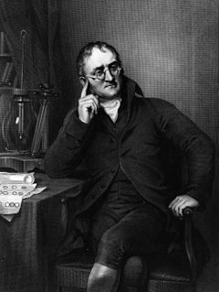
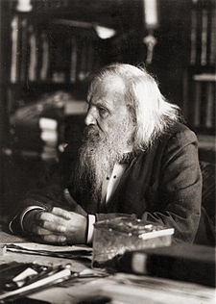
History of chemistry
1808: John Dalton, a English scientist, suggested that each element has its own kind of atom.
To explain his model Dalton used symbols to represent various elements.
In the late 1860’s Dmitri Mendeleev developed the idea of the Periodic Table
an arrangement of the elements by their physical and chemical properties and masses.

Slide 4
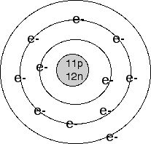
When atoms approach one another, it is their electrons that interact.
The 1st widely accepted explanation for the arrangement of these electrons was put forward by Danish physicist Niels Bohr (1885 – 1962).
In 1913, Bohr proposed a model of the atom that helped explain the movement of electrons around the nucleus of an atom in orbits or energy levels.
1911: Ernest Rutherford proposed his nuclear model of the atom.
Nucleus
Protons
electrons

Slide 5
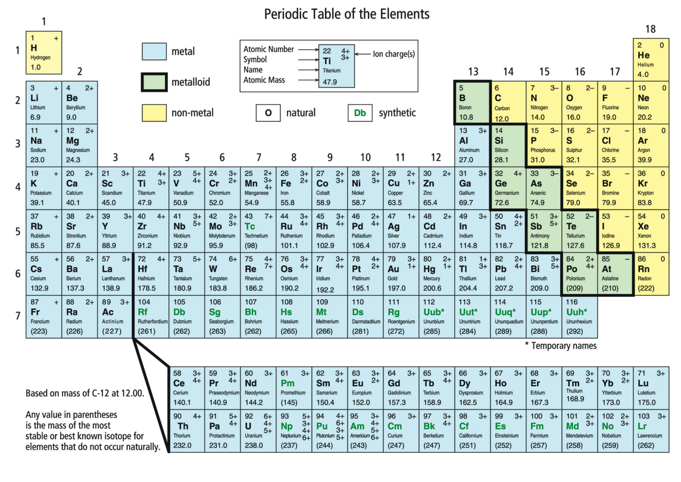
6.2 Naming and Classifying the Elements

Slide 6
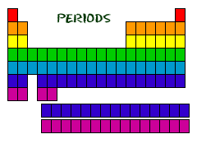
Periods
Horizontal rows of elements are called periods.
lists the elements in horizontal rows with masses increasing from left to right.
As you go from left to right within a row, the elements gradually change from metallic to non-metallic, then finally to the noble gases at the extreme right.

Slide 7
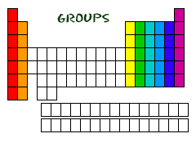
Groups
It also forms vertical columns called groups
elements with common properties
Chemical Families
Vertical columns of elements are called families and have similar chemical and physical properties.
These groups occur as vertical columns on the modern periodic table.
There are 5 common families in the periodic table

Slide 8
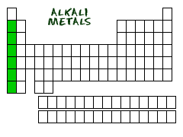
Alkali Metals (Group 1)
Li, Na, K, Rb, Cs, Fr
Ion charge of 1+
Soft, low density silvery- grey metals
Never found as pure elements in nature; very reactive.
Most active metals on periodic table.
Excellent heat and electrical conductors.

Slide 9
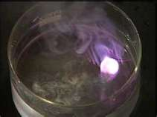
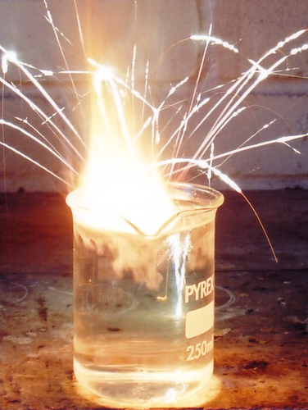
Alkali Metals
Lithium in water
Potassium in water

Slide 10
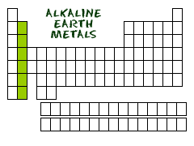
Alkaline Earth Metals (Group 2)
Be, Mg, Ca, Sr, Ba, Ra
Ion charge of 2+
Hard, low density, silvery-white metals
React with air and water

Slide 11
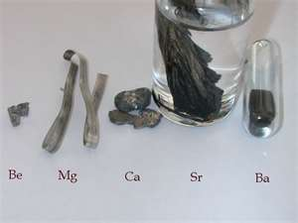
Alkaline Earth Metals

Slide 12
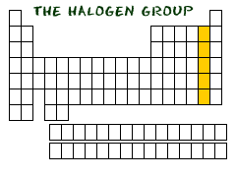
Halogens (Group 17)
F, Cl, Br, I, At
Ion charge 1-
Never found as pure elements in nature; very reactive.
Most reactive non-metals on periodic table.
Range of bright colours as gases

Slide 13
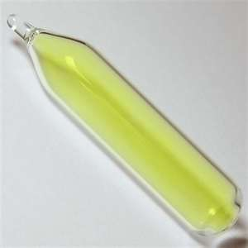
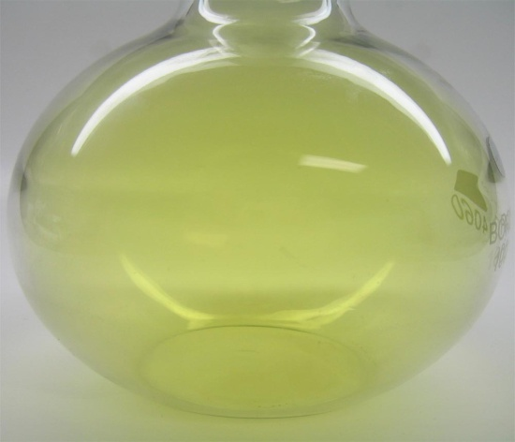
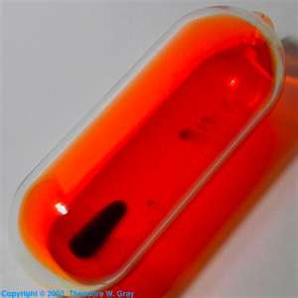
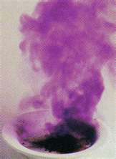
Halogens
Fluorine
Chlorine
Bromine
Iodine

Slide 14
Noble (Inert) Gases (Group 18)
He, Ar, Xe, Ne, Kr, Rn
No ion charge
Colourless, odourless, tasteless, non-reactive gases
Do not react with other elements
Melt and boil at low temperatures

Slide 15
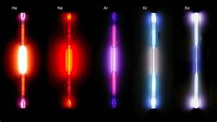
Noble Gases

Slide 16
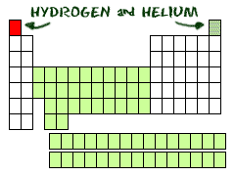
Hydrogen: A Family of One
H = Hydrogen
Ion charge of 1+ or 1- depending on whether it gains or loses its electron
Lightest, most common element
Melts and boils at low temperatures.
Colourless, tasteless, poor heat and electrical conductor, highly flammable.

Slide 17
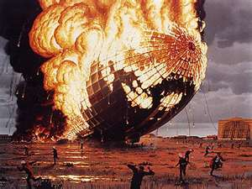
Hydrogen

Slide 18
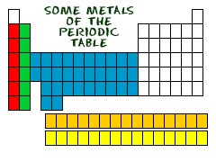
Classifying the Elements
The elements on the periodic table are divided into 3 main groups based on their properties:
Metals tend to be shiny, malleable, ductile, good conductors and solid at room temperature.
Non-metals tend to be dull, brittle, poor conductors and are often gases at room temperature.
Metalloids (Semi-Metals) tend to have some of the properties from each of the above groups.

Slide 19
Metals (blue), Non-metals (yellow) metalloids (pink)

Slide 20
6.3 Putting the elements in order

Slide 21
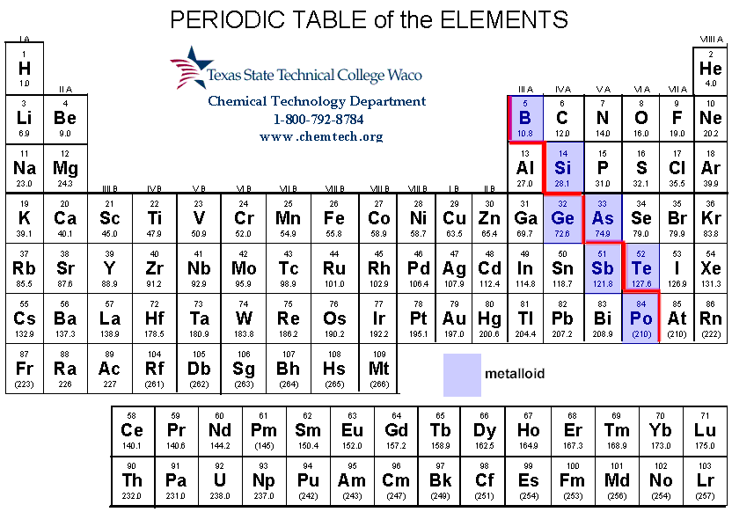
Organizing The Elements
There are about 100 naturally occurring elements
The zigzag staircase line separates the metals on the left from the non-metals on the right.

Slide 22
The Modern Periodic Table

Slide 23
Symbols
Based on their Latin names
Elements such as gold were used by the Latin speaking Romans.
Latin was used throughout Europe for more than a thousand years.
Even after the Roman Empire collapsed the scholars continued to use Latin.
To keep the system consistent, even elements that have been discovered recently have been given latinized names.
Ie. Einsteinium, Berkelium.

Slide 24
English and Latin names for Elements
English name | Symbol | Latin Name
Carbon | C | Carbo
Copper | Cu | Cuprum
Iron | Fe | Ferrum
Lead | Pb | Plumbum
Silver | Ag | Argentum

