Slide 1
Chapter #7
Atomic Theory

Slide 2
7.1 & 7.3
Development of a Modern Atomic Theory & The Modern Periodic Table

Slide 3
The Modern Periodic Table
Elements are classified in many ways:
  Physical properties: metals, non-metals & metalloids
  Families: alkali metals, transition metals, halogens, earth metals, alkaline earth metals, noble gases
  Ion charges: # of electrons
  Atomic number: # of protons in the nucleus
  Electron arrangement
Mendeleev’s Design allows us to include all these classifications

Slide 4

The Structure of the Atom
Atoms can be split into smaller, simpler particles called subatomic particles.
There are 3 subatomic particles:
Protons (p⁺) have a positive charge and a mass of 1.
Neutrons (n⁰) have no charge and a mass slightly more than 1.
  Protons and neutrons are located in the center of the atom in an area called the nucleus.
Electrons (e⁻) have a negative charge and almost no mass.

Slide 5
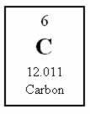
Atomic Number
The number of p⁺ in the nucleus of an atom of an element is its atomic number.
  In a neutral atom, the atomic number is also equal to the number of e⁻.
Atomic number for Carbon is 6
  How many protons does it have? Electrons? 6 of each
What are the atomic numbers for:
  Oxygen? 8
  Sodium? 11 also number of p⁺ and e⁻
  Nickel? 28

Slide 6
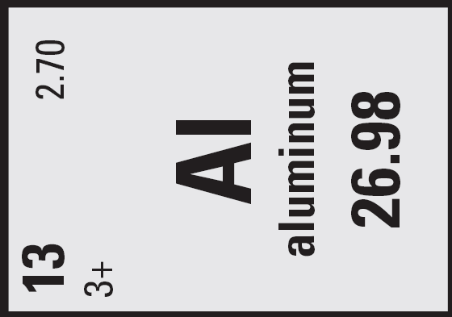
Calculating # 0f Electrons
The number of protons in the nucleus of an atom does not change when the atom forms an ion (atom with a charge)
Only the # of electrons orbiting the nucleus can change.
  Ex. Aluminum
Atomic # = 13
    13 p+ and 13 e-
    If it was a neutral atom (no charge), it would have 13 e-
    Aluminum ATOM would have 13 e-
Ion charge = 3+
  Atomic # - charge
  13 – (+3)
  10 electrons
  Aluminum ION would have 10 e-

Slide 7
Mass Number and Atomic Mass
The mass number of an element is an integer and represents the total number of p⁺ and n⁰ in the nucleus of the atom.
  This is NOT found on the periodic table.
It is often confused with the atomic mass which is found on the periodic table.
  The atomic mass represents the average of all the different forms of an element and is often a decimal.
To convert from atomic mass to mass number, round the value on the periodic table to the nearest whole number.
  Ex: Lithium
  Atomic mass = 6.94
  Mass number = 7

Slide 8
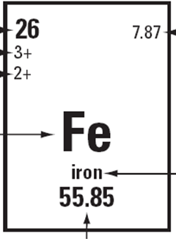




Example: Element Iron
  number of p⁺ and e⁻
total number of p⁺ and n⁰
round this # to the nearest whole number to get MASS NUMBER

Slide 9
Examples
Ex #1: Lithium
  Atomic mass = 6.94
  Mass number = 7
  Atomic number = 3 ∴3 protons, 3 electrons
  Mass number = p⁺ + n⁰
  7 = 3 + n⁰
    n⁰ = 4
  # of Electrons
    = atomic # - charge
    = 3 – (+1 )
    = 2 electrons
Ex #2: Nickel
  Atomic mass = 58.7
  Mass number = 59
  Atomic number = 28 ∴28 protons, 28 electrons
  Mass number = p⁺ + n⁰
  59 = 28 + n⁰
    n⁰ = 31
  # of Electrons
    = atomic # - charge
    = 28 – (+2 )
    = 26 electrons

Slide 10
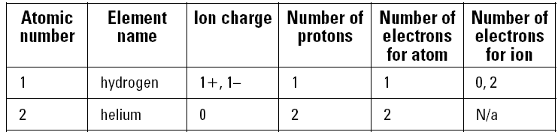
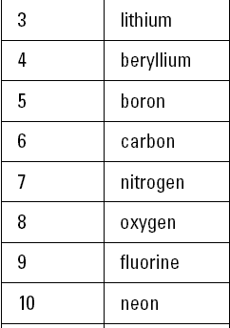




Try This: Atoms and Ions (pg. 216)

Slide 11
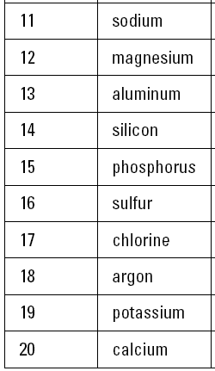






Slide 12
Isotopes
Sometimes atoms of the same element have different mass numbers.
When this occurs, they are called isotopes of the element.
The atomic mass of an element is the average mass of an elements naturally occurring atoms, or isotopes.
This is rarely a whole number.
E.g. hydrogen has 3 naturally occurring isotopes
  H¹ 1p⁺ 0n⁰
  H² 1p⁺ 1n⁰
  H³ 1p⁺ 2n⁰

Slide 13

Standard Atomic Notation (S.A.N)
Two common ways to refer to isotopes are with the name and the symbol:
Name: ex. Uranium –238
  the 238 refers to the mass number
Symbol: symbol with mass number and atomic number
Mass number
Atomic number

Slide 14
7.2 & 7.4
Bohr’s Theory of the Atom & Using the Bohr Theory

Slide 15
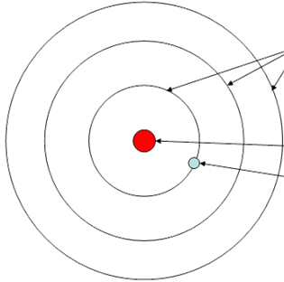


Atoms, Ions and the Bohr Model
When atoms approach one another, it is their electrons that interact.
  Niels Bohr model of the atom explains the movement of electrons around the nucleus in orbits or energy levels.
  Each orbit is a certain distance from the nucleus and contains a definite number of electrons.
  Electrons are located in shells/orbitals or energy levels surrounding the nucleus.
    After each orbit (energy level) is filled, the next orbit is then filled.
1
2
3

Slide 16
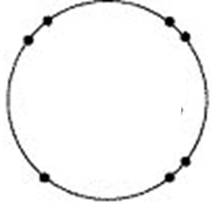
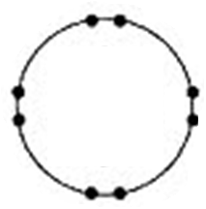
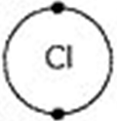
Valence Electrons
  There are a maximum of 2 electrons in the 1st energy level
  8 electrons in the 2nd orbital
  8 electrons in the 3rd orbital
  The electrons found in the outermost orbital are called valence electrons.
  All the electrons in levels other than the outermost level are called inner electrons.
This atom has 7 valence electrons

Slide 17


Bohr Diagram
  The 1st orbit can hold a maximum of 2 e-.
  Orbits 2 and 3 can hold a maximum of 8 each.
  How do we show this with elements?
  E.g. Sodium ATOM
    Atomic # = 11 ∴11 p⁺ and 11 e⁻
    Atomic Mass = 23 ∴ 12 n⁰
(11 electrons total)
2 e⁻ go in 1st orbit
8 e⁻ go in 2nd orbit
1 e⁻ goes in 3rd orbit

Slide 18
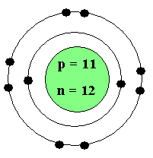
Ions
Atoms that have gained or lost electrons are called ions.
The goal of every atom is to gain or lose enough electrons to either completely empty or completely fill their outermost orbital.
  If an atom loses electrons it becomes positively charged.
  If an atom gains electrons it becomes negatively charged.
  SODIUM ION
  Sodium has one valence electron.
  Is it easier to gain 7 or lose 1?
  Therefore, sodium will become positively charged because it still has 11 p⁺ and now only 10 e⁻.
  The resulting Bohr model would have only 10 electrons.
Lose 1

Slide 19
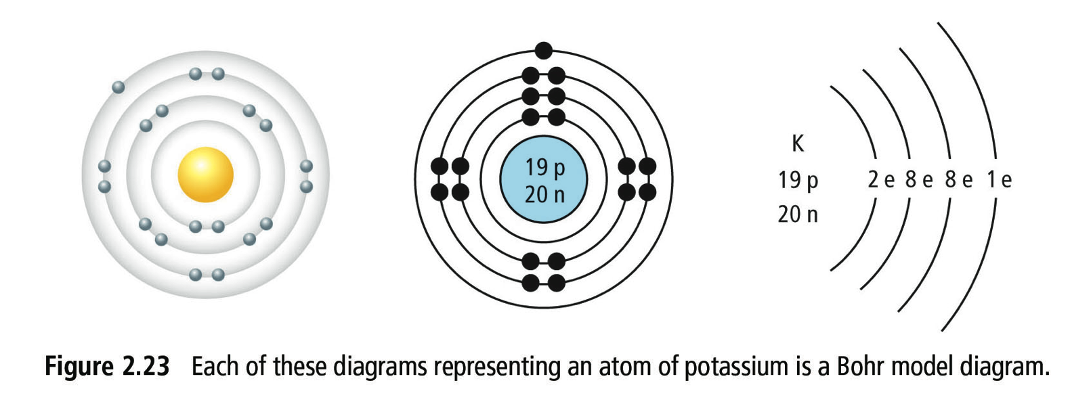
Bohr Model Diagrams for Potassium ATOM

Slide 20
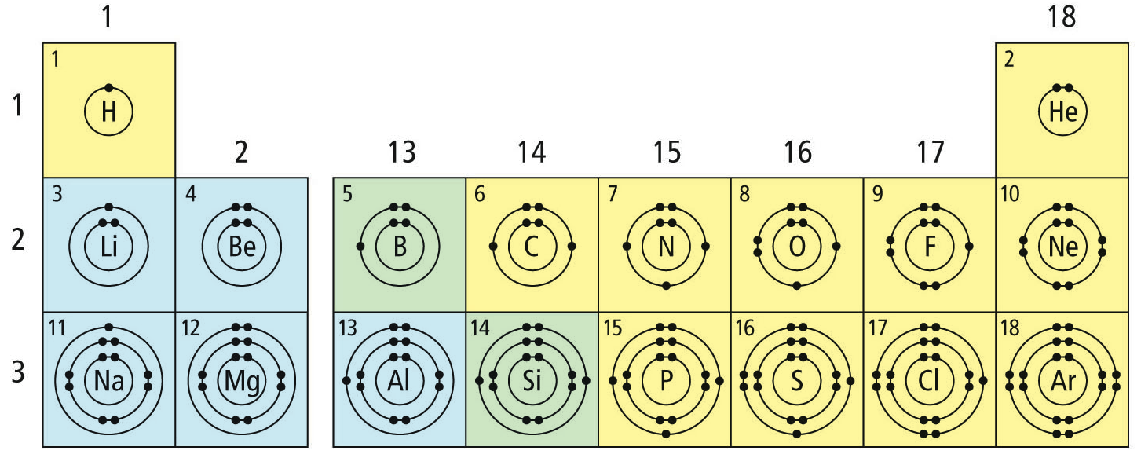
Bohr Models for the first 18 Elements (atoms)

